Slide 1
Team - ML_Newbies
Problem Statement - 05
Dhanesh Kumar A C
Nidharshan A
Monishver C

Slide 2
POWER QUALITY CLASSIFICATION USING ML
A time series data corresponding to different power quality conditions are given. The objective is to determine a deep learning model that can classify them effectively.
Criteria for evaluation is
1) Accuracy
2) Model size (smaller the better)
3) CPU time to run 1 round of classification

Slide 3
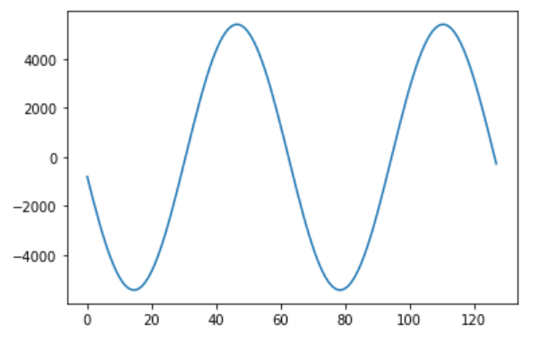
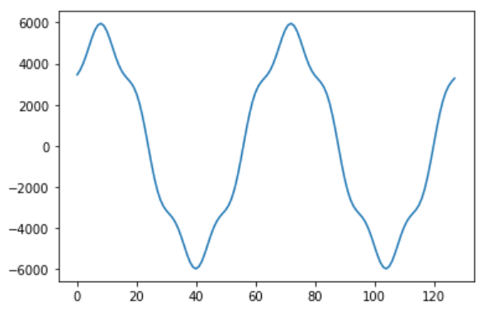
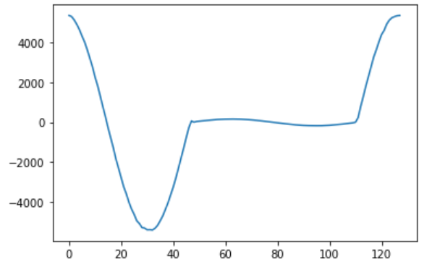
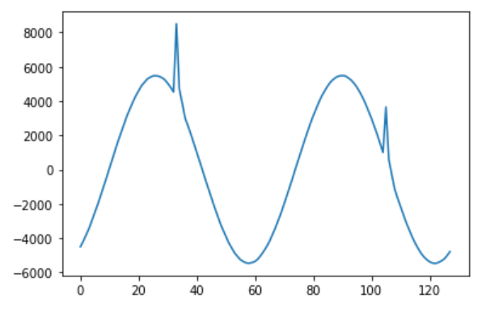
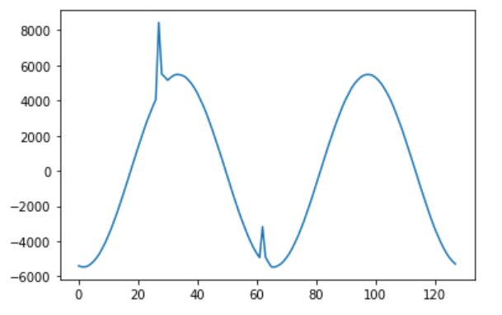
General analysis and insights obtained :
The Given dataset is well-balanced, and the classes are well differentiable.
Class - 01
Class - 02
Class - 03
Class- 04
Class - 05

Slide 4
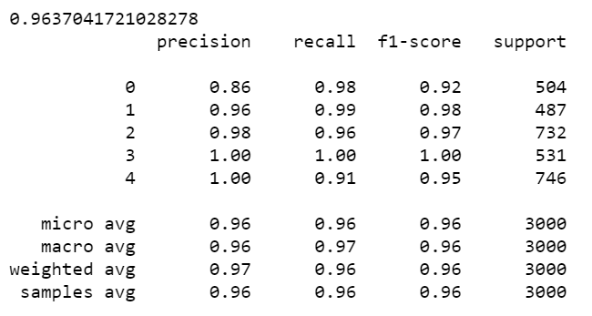
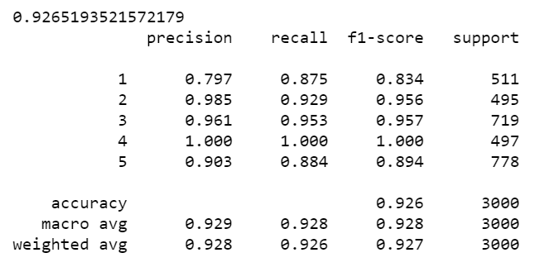
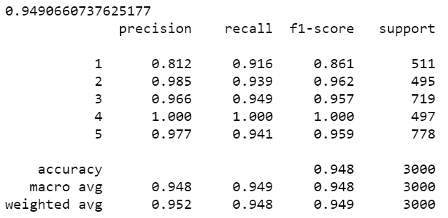
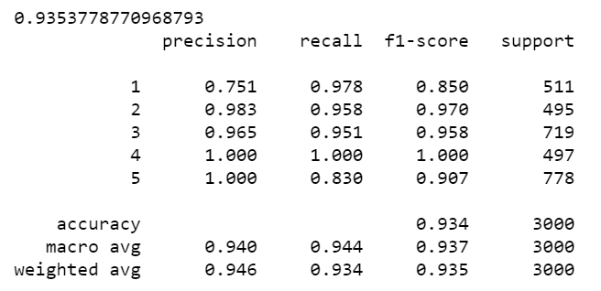
Machine Learning Models Used :
Random-Forest
K- Nearest Neighbors
XGBoost
Maximum - Vote Classifier

Slide 5
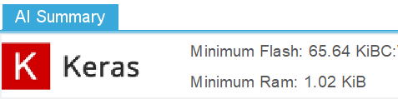
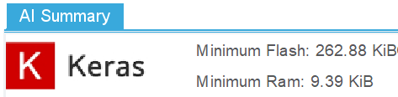
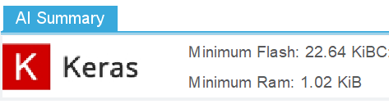
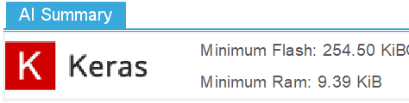
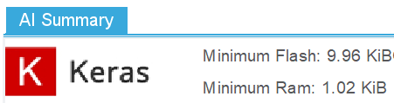
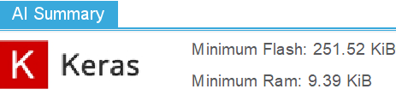
Deep Learning Models Used :
Deep Neural Network :
Accuracy - 99% (both Training and testing)
Used Callbacks
Epochs - 400
Model Size :
After Compression without Loss :
Time Taken for 1 Prediction:
DNN + LSTM + CNN :
Accuracy - 99% (both Training and testing)
Used Callbacks
Epochs - 50
Model Size :
After Compression without Loss :
Time Taken for 1 Prediction:

Slide 6
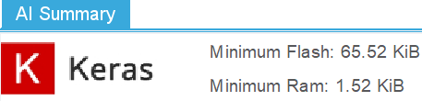
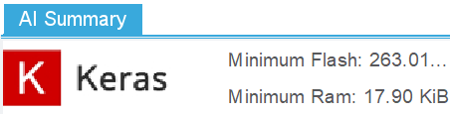
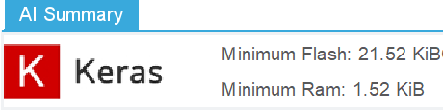
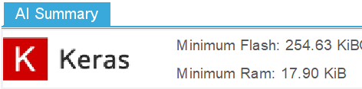


For Dataset 2 with 256 feature values and 6 classes:
Deep Neural Network :
Accuracy - 98% (Training) and 95% (testing)
Reduced 1 hidden layer.
Epochs - 650
Model Size :
After Compression without Loss :
Parameters :
DNN + LSTM + CNN :
Accuracy - 99% (both Training and testing)
Used Callbacks and dropouts
Epochs - 25
Model Size :
After Compression without Loss :
Parameters :

Slide 7
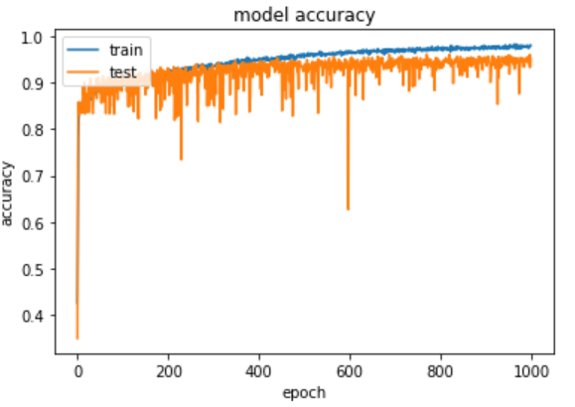
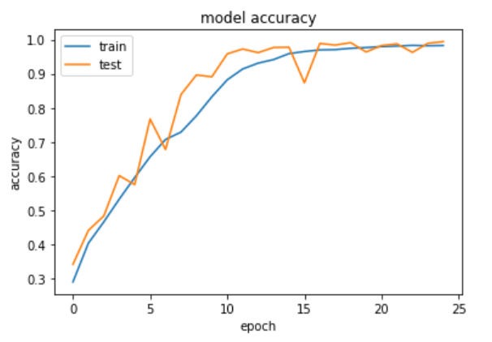
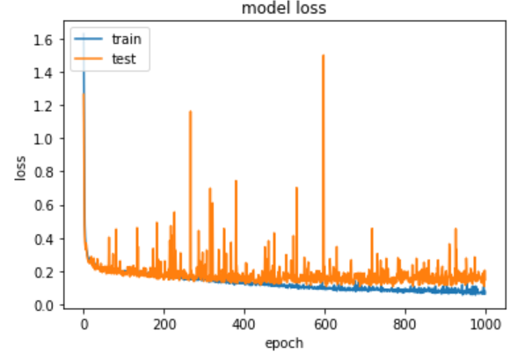
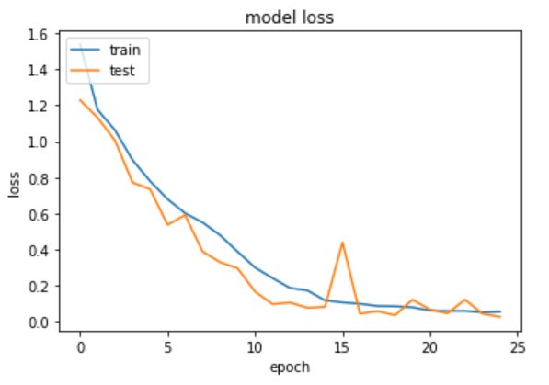
For Dataset - 02 (With 256 features and 6 classes) :
DNN ( Optimized ) :
DNN + LSTM + CNN

Slide 8
Inferences :
Deep learning models was more accurate in classification than ML models.
Combination of many deep learning architectures results in a more accurate and uniform accuracies.
Now a Days, most of the Micro-controllers have a flash of minimum 1MB, so our models can be easily accommodated.
Since, we are not sure of the specific Microcontroller that HoneyWell uses in its product, we tried with standard STM32F746ZGTx for our analysis. Also we generated the source file which could be used for deploying it in microcontroller.
Working On :
We are working on STM32CUBE.AI for deployment of the model.
We are trying to superimpose two wave-forms using interference concepts, for making in-depth analysis for classifying it as multi-nomial.

Slide 9
Thank You.

